Slide 1

TEN EASY STEPS TO APPLY FOR GRADUATE SCHOOL (Noodle, 2018)

Slide 2


Best Two Reasons to go to Grad School (OSU 2018)
The love for a particular subject and the desire to study it in depth.
MA/ MS? Ph.D.? Combined
program?
The need for an advanced degree to enter the profession of your choice.
MBA, MS Accountancy,
MA ESL, MA HR
High rates of passing the CPA: Manchester University (Indiana).

Slide 3
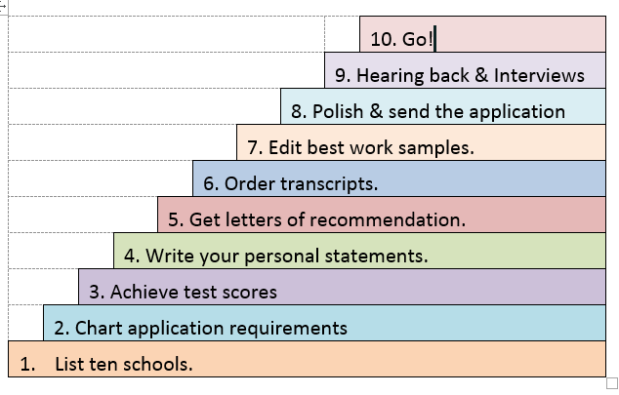
10 steps in applying to Grad School

Slide 4
STEP 1: MAKE A LIST OF TEN SCHOOLS
REACH SCHOOLS – dream schools
SOLID CHANCE SCHOOLS -- very likely to accept you
SAFETY SCHOOLS – certain acceptance

Slide 5

How to find out about schools
US college rankings: https://www.usnews.com/best-colleges/rankings
Also search for “Best Graduate Schools in . . . [your field]”

Slide 6
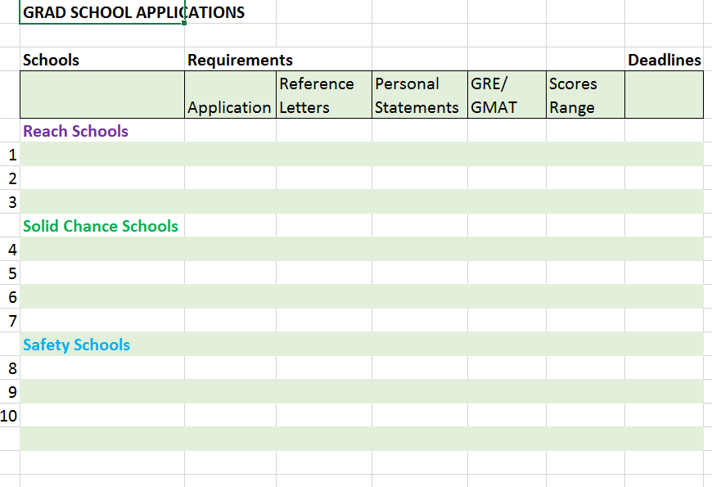
2. Make a list of requirements.
Make a spreadsheet of all schools requirements & deadlines

Slide 7
3. IELTS/ TOEFL/ GREs/ GMATs
Note on your application spreadsheets what scores each school seeks
Take an online practice test. Do you score in the range the schools want?
If not, take a prep course or a tutor
Note their deadlines and compare the schools’ deadlines.
TOEFL- China. http://www.toefl.givemesomeenglish.com/toefl-testing-dates-and-locations/toefl-testing-dates-and-locations-by-country-letter-c/china-toefl-testing-dates-and-locations/
GMAT- China: https://www.eduers.com/gmat/gmat-test-centers-in-china/

Slide 8
Write your personal statements.
STRUCTURE according to each universities’ questions.
Attention Step: stand out from the crowd. Make it great!
Discuss what strengths you can provide to the school.
Is there a professor you really want to work with? Describe your interest. Why do you want to work with them? Why do you want to go to this school?
Conclusion: Final summary, clincher
Give a copy to your referees
Get help proofreading your personal statement. Make it perfect.

Slide 9

5. Letters of Recommendation
Most schools now use an online form
Ask in advance that the faculty member agrees to recommend you
Ask what they will say about you. Get different content from each referee.
Give referees plenty of time
Give them an early deadline, so their letters don’t make your application late
Follow-up

Slide 10
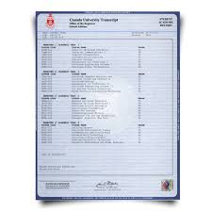
6. Transcripts
How much time do they take to be sent & received?
How much do they cost?
Time them for when your application arrives.

Slide 11
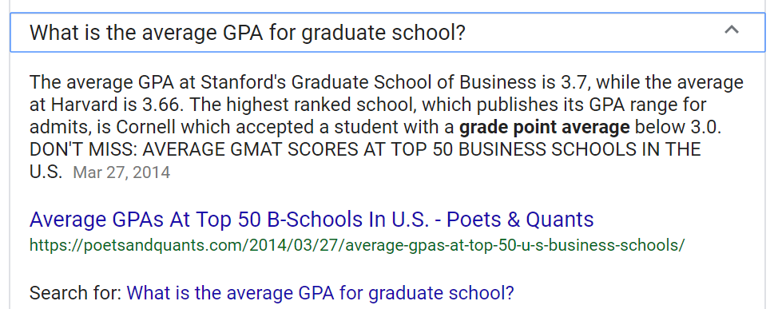

Slide 12

7. Examples of your best work
Tailor to your MA/ MS interests, prospective advisor
Include research, publications, conference papers, senior projects, video projects, audits completed in an internship (hide company names)
Polish, get editing help so they really shine

Slide 13

8. Revise and send your Application
Proofread carefully
Try to apply one month in advance
Most schools reply by April 15th.

Slide 14

9. Hear back and interview
Invited for an interview
Speak specifically about why that university
Rehearse your interview

Slide 15

10. Go
Visa
Packing
Flight

Slide 16
Timetable (Shorter, 2017).
Start Early
Junior year, January-March. Who will you ask for recommendation letters?
Build relationships with them.
Need 3-4 academics who can discuss your work.
At least one should be able to discuss how you fit your chosen field.
Plan to work with them, choose your research topic for grad school.
Will to want to take a test prep course (GRE, GMAT, etc.)
January-June: Decide on your future field

Slide 17
Timetable, continued
June-August: investigate the field of your ideal future. Which schools teach it?
Summer months: make notes about readings that excite you in your area. Whose researching in your interest area? Whose work excites you? What other topics have they worked on? Where do they teach? Which schools require GREs/ GMAT scores?
August-September: Seek an advisor: 1) Are they expecting to continue their work in the areas you find relevant? And (2) do they expect to be working with graduate students in the coming years?

Slide 18
Timetable, continued
August- September: Contact referees to ask for letters. Give relevant docs (resume, personal statement). Ask for personal statement editing.
TOEFL/ GRE
October 31- 1 December:
Submit your application materials on time—and wait.
March 1- April 15: Admission letters

Slide 19
REFERENCES
Career Counseling and Support Services, The Ohio State University. Applying to
graduate schools. (2017). Applying to Graduate Schools. https://ccss.osu.edu/posts/documents/applying-to-grad-school-web-version-2014.pptx
Malcolm, R. (2012, March 19). How to apply to graduate school in 10 easy steps.
Noodle. https://www.noodle.com/articles/how-to-apply-to-grad-school-in-10-easy-steps
Randolph, K.K. (2018, March 24). Timeline for applying to graduate school.
Fastweb. https://www.fastweb.com/college-search/articles/timeline-for-applying-to-graduate-school
Shorter, D. (2017, April 17). The gentle guide for applying to graduate schools. The Chronicle
of Higher Education. https://www.chronicle.com/article/The-Gentle-Guide-for-Applying/239768
U.S. News & World Report, Education. (2018). Applying for graduate school.
https://www.usnews.com/education/best-graduate-schools/top-graduate-schools/applying.

